Slide 1
You Gray Hairs Haven’t Done Nothing
(and Pat Helland Thinks We Don’t Have the Balls To Tell You)
Daniel Abadi, Shawn Jeffery and the other young whippersnappers

Slide 2
You think you’ve solved these?
Mobile Databases
Biological Databases
Distributed Databases
Ubiquitous Databases

Slide 3


Mobile Databases
AI + Databases + Robots!
The DBA of the Future

Slide 4

Biological Databases
Databases that understand what they are storing
Databases that can think

Slide 5

The impending Mobile DB vs Biological DB War (And you thought Relational vs Hierarchical was Bloody!)

Slide 6
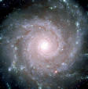
Distributed Databases
(Interplanetary Distribution)
Finally, we no longer have to worry about being I/O bound!

Slide 7

Ubiquitous Databases
(Hyper-Ubiquity)
IPv6: 3.7x10²¹ addresses per square inch of the earth's surface
What if we used them all?

Slide 8
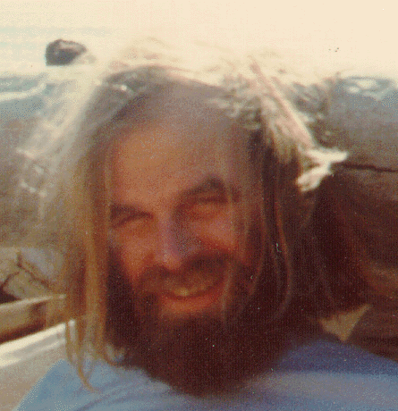
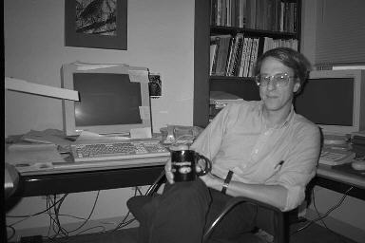

The Golden Age of Computer Science?

Slide 9
Roadmap
CS Excitement Factor
NOW
Gray hairs retire
Probabilistic wallowing
Ubiquity Avalanche
P != NP
AI!
The Golden Age of Computer Science

